Slide 1
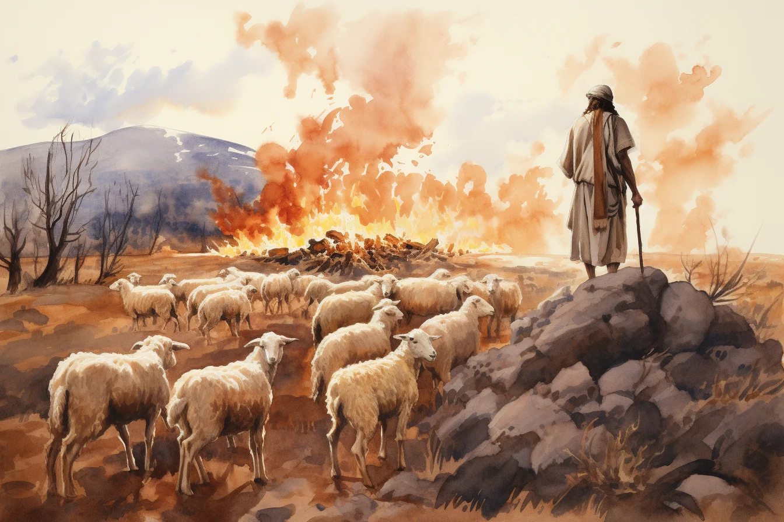
Exodus 出埃及記 3:11-22 Moses and Parenting
https://ffoz.org/torahportions/parashah/shemot
親子靈修 William分享
08-01-2025
 | Bible Reading Exodus 3:11-22 (Optional) | Time
1 | CUV in Chinese or Cantonese (Audio) | 4 min
2 | NIV Bible Reading in English (Audio) | 4 min
3 | Moses & Burning Bush English (ChildrenVideo) | 3 min
4 | Chinese Video | 6 min

Slide 2
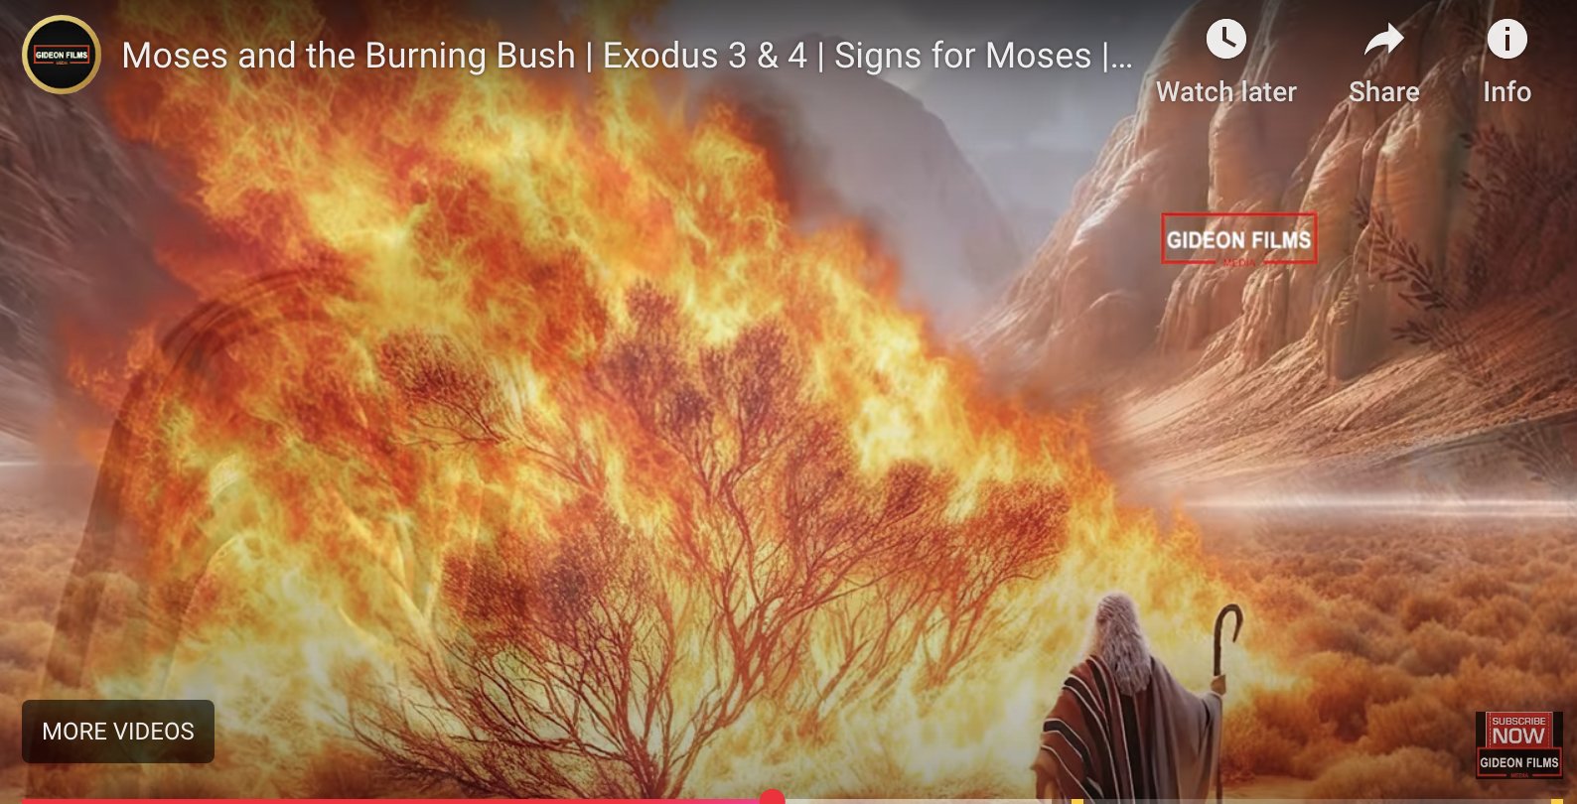
https://wdingbox.github.io/accc_2025_pp/ppt/Exodus/exo3_1_11.htm
Exodus 3:1-11. (Video Youtube)

Slide 3
出埃及記(Exodus) 3:11-22 簡介
經文取自《聖經和合本NIV》— 漢語聖經協會出版，承蒙允准使用。
Key Figures 要人 | Descriptions
God | 1. God’s Command 神的命令(3:10), 2. God’s Promise 神的应许(3:12) 3. God’s Sign 神的证据(3:12), 4. God’s Assurance 神的保障 (3:14) 5. God’s Love 神的爱 (3:10-22)
Moses 摩西 | 1. Inferiority 自卑. (3:11) 2. Doubtfulness 疑惑 (3:13) 3. Uncertainty 不确定 (3:13) 4. No Faith 没有信仰 (3:13) 5. No confidence 没有信心 (3:13)
Israelites 以色列人 | Misery (困苦), crying (哀声), suffering (痛苦) (3:7)

Slide 4
The Establishment of a Trilateral Relationship: God-Moses-Israelites (GMI) (神-摩西-以色列人) 三边关系的建立: God’s Command神的命令
“I have indeed seen the misery of my people in Egypt. I have heard them crying out because of their slave drivers, and I am concerned about their suffering” “我的百姓在埃及所受的困苦、我实在看见了．他们因受督工的辖制所发的哀声、我也听见了．我原知道他们的痛苦“ (3:7)
God
- “Moses Moses”
- “Here I am” “我在这里” (3:4b)
"So now, go. I am sending you to Pharaoh to bring my people, the Israelites, out of Egypt." “我要打发你去见法老、使你可以将我的百姓以色列人从埃及领出来”
(3:10)
Moses 摩西
Israelites
以色列人

Slide 5
The Establishment of a Trilateral Relationship: God-Moses-Israelites (GMI) (神-摩西-以色列人) 三边关系的建立: God’s Promise and Sign 神的应许与证据
And God said, "I will be with you. And this will be the sign to you that it is I who have sent you: When you have brought the people out of Egypt, you will worship God on this mountain.” 神说、我必与你同在、你将百姓从埃及领出来之后、你们必在这山上事奉我、这就是我打发你去的证据 (Exo3:12 CUVS)
God
Moses said to God, “Who am I, that I should go to Pharaoh and bring the Israelites out of Egypt?” 摩西对 神说、我是甚么人、竟能去见法老、将以色列人从埃及领出来呢。 (Exo3:11 NIV CUVS)
Moses 摩西
M
Israelites
以色列人
M

Slide 6
The Establishment of a Trilateral Relationship: God-Moses-Israelites (GMI) (神-摩西-以色列人) 三边关系的建立: God’s Assurance 神的保障
Moses said to God, “Suppose I go to the Israelites and say to them, 'The God of your fathers has sent me to you,' and they ask me, 'What is his name?' Then what shall I tell them?” "摩西对 神说、我到以色列人那里、对他们说、你们祖宗的 神打发我到你们这里来．他们若问我说、他叫甚么名字、我要对他们说甚么呢。 (Exo3:13 CUVS)
God said to Moses, “I am who I am . This is what you are to say to the Israelites: 'IAM has sent me to you.’ ” 神对摩西说、我是自有永有的．又说、你要对以色列人这样说、那自有的打发我到你们这里来。(Exo3:14 CUVS)
God
Moses 摩西
M
Israelites
以色列人
M

Slide 7
Parenting Question to God
God
“Who am I, that I should go to teach my children about God?”
“我是甚么人、竟能去教导我的孩子们认识上帝?”
Parents
父母
Children
孩子

Slide 8
Parenting Question to God
God
“Suppose I go to the children and say to them about God, and they ask me, ‘Who is God?' Then what shall I tell them?” 我到孩子们那里、对他们讲论说 神. 他们若问我说、神是甚么?、我要对他们说甚么呢?
Parents
父母
Children 孩子

Slide 9
Theological Question
What is the theological meaning of going to Pharaoh? 去见法老的神学意义是什么？ What is the theological meaning of bringing the Israelites out of Egypt? 带领以色列人出埃及的神学意义是什么？ How can parents bring their children out of the world today? 父母该如何带领孩子脱离世俗？

Slide 10
個人反思 & 教養智慧
個人反思：
“我愿意让孩子相信神，但对我来说无所谓 。” 对吗?
“I hope my children to believe in God. But it doesn’t matter to me.” Is that right?
教養智慧：
"至于我、和我家、我们必定事奉耶和华。" (Jos24:15 CUVS)
“as for me and my household, we will serve the Lord ." (Jos24:15 NIV).

Slide 11
Closing Prayer
Dear Heavenly Father, the Glorious Lord, the Creator, and Sovereign of all things. Thank you for your mercy and grace. Thank you for calling us, the parents. Thank you for giving us, the parents, the educational authority. Our children are your heritage. We are the sinners; we do not deserve it. May Your Holy Spirit call us, guide us. Bless our children and young generation to be able to know you, follow you to be the devotional generation. May your name be glorified, generation by generation, and forever. I pray in the name of Jesus. Amen.

Slide 12
1.No Turning Back
https://www.youtube.com/watch?v=yNtid3wdDWA&list=RDyNtid3wdDWA&start_radio=1&ab_channel=GaiseBaba
Christian Kids
2. The Song of Moses https://www.youtube.com/watch?v=a-wWKL-7Mrg
The Song of Moses Like You've Never Heard Before | Christian Worship Song/ World Wide Worship

